Slide 1
Congregation Beth Shalom – Sanctuary Addition
Schematic Design + Estimate
Preston Scott Cohen. Inc

Slide 2
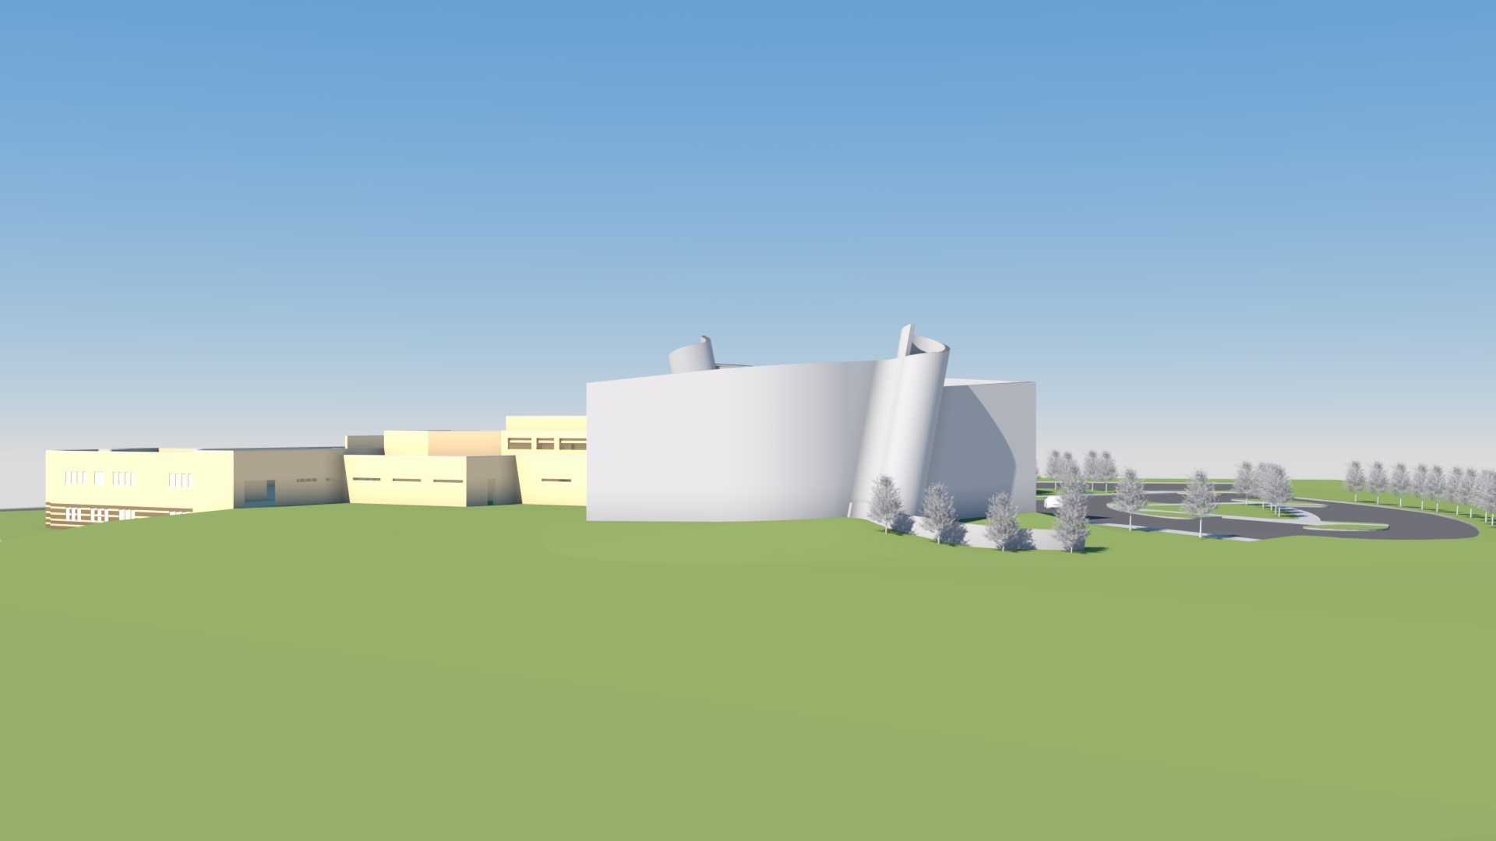
Beth Shalom Schematic Design 02-10-20
3D view

Slide 3
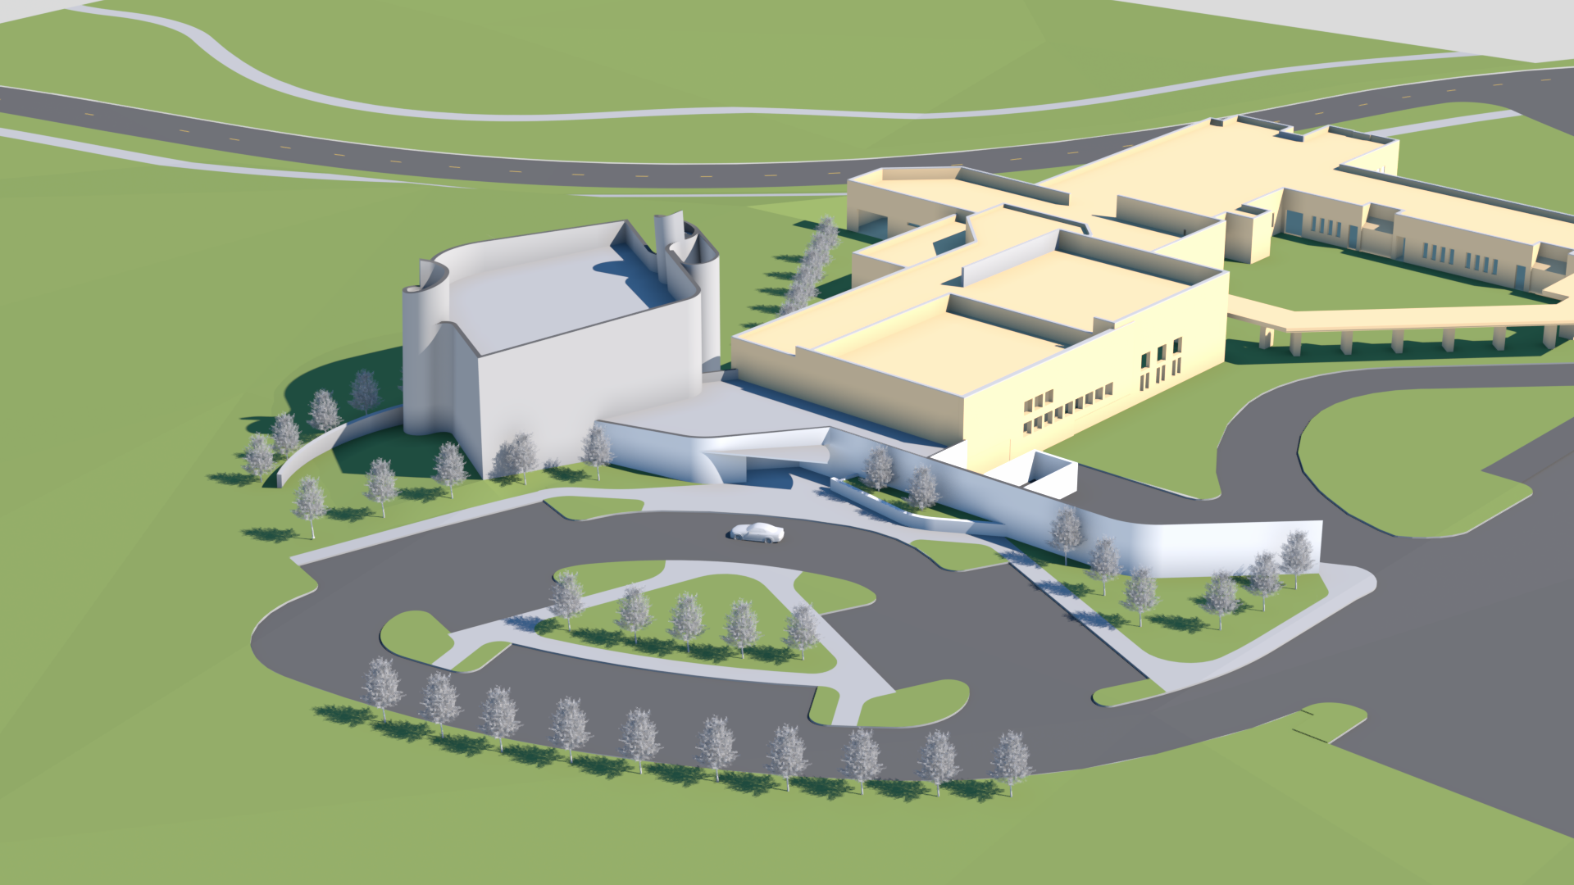
Beth Shalom Schematic Design 02-10-20
3D view
Congregation Beth Shalom – Sanctuary Addition

Slide 4
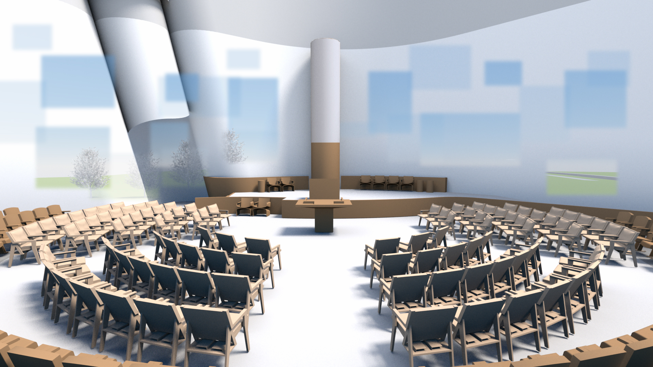
Congregation Beth Shalom – Sanctuary Addition

Slide 5
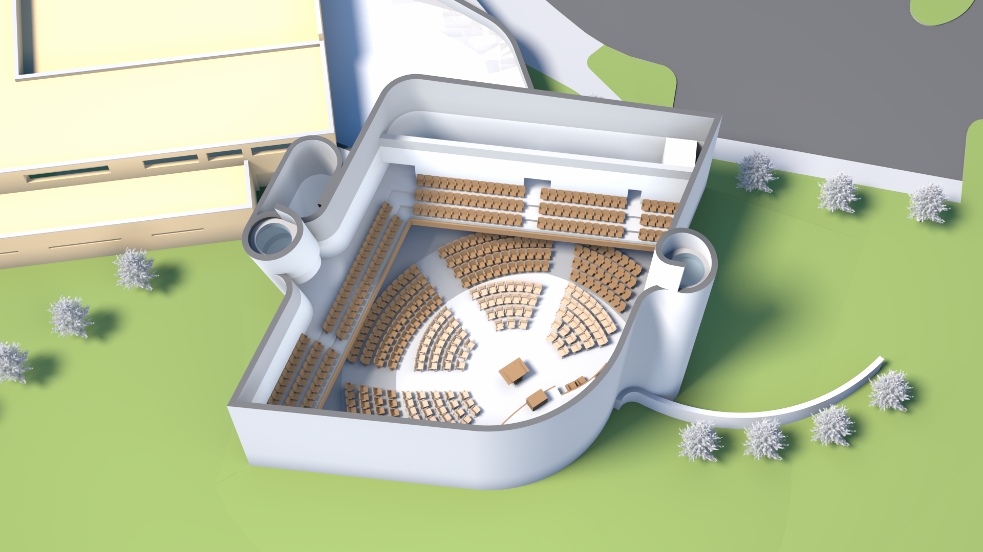
Balcony: 164 seats
Pews: 192 seats
Central Chairs: 110 seats
Total Shabbat: 466 seats
Congregation Beth Shalom – Sanctuary Addition

Slide 6
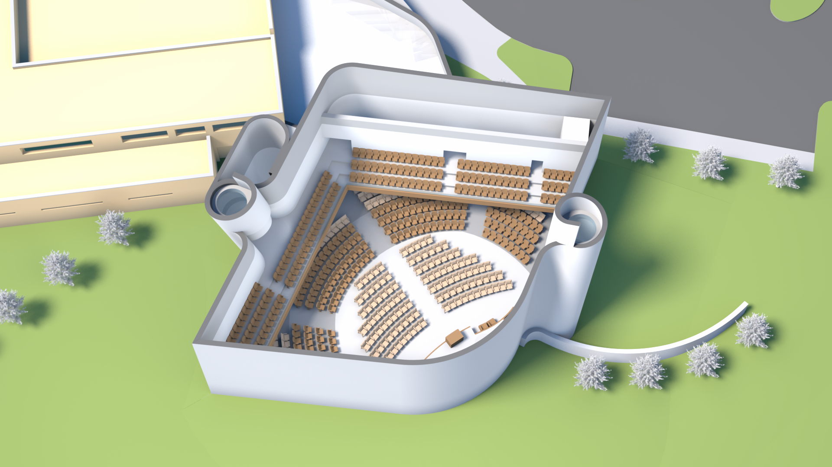
Extra Rear Chairs: 47
Balcony: 164 seats
Pews: 192 seats
Central Chairs: 116 seats
Total High Holidays: 519 seats
Congregation Beth Shalom – Sanctuary Addition

Slide 7
Schematic Design 02-10-20
11,525 sf Sanctuary + Lobby, Restroom
Total: 11,525 sf
By Area Added Together
Flat Chair (Shabbat): 110 110
Sloped Pews: 192 302
Balcony: 164 466
Total (Shabbat): 466
By Area Added Together
Flat Chairs (High holidays): 116 116
Sloped Pews: 192 308
Balcony: 164 472
Chair Additions: 47 519
Total (High holidays): 519
Square footage and seating
Preston Scott Cohen. Inc
Congregation Beth Shalom – Sanctuary Addition

Slide 8
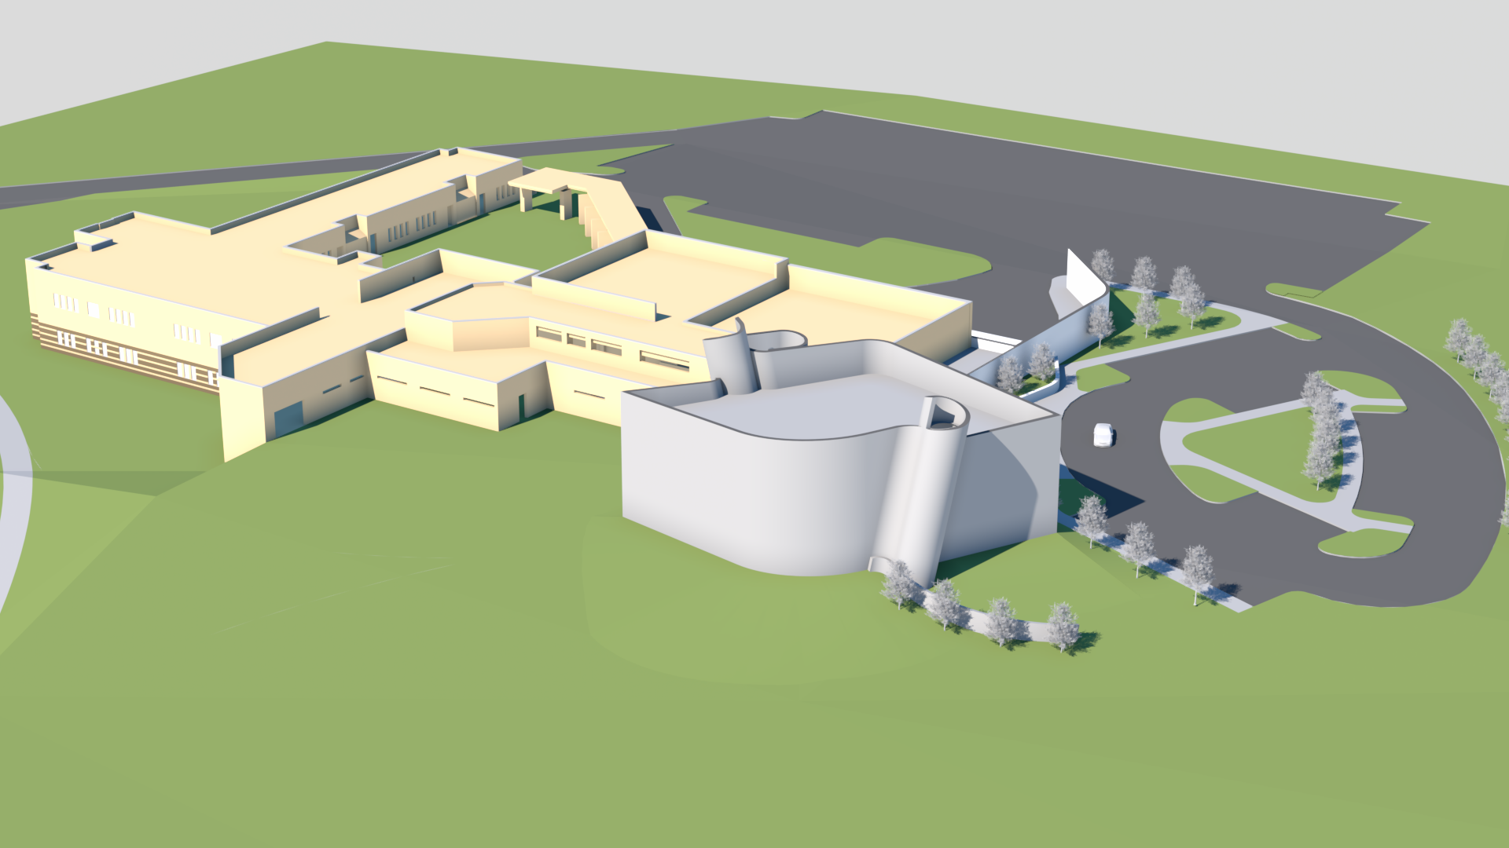
Beth Shalom Schematic Design 02-10-20
3D view
Congregation Beth Shalom – Sanctuary Addition

